Slide 1
Music Genre Classification
DTSA 5511 Final Project

Slide 2

Table of Contents
Introduction
Data Sources
Processing
EDA
Modeling
Analysis
Conclusion
Album Cover: Book of Dreams by The Steve Miller Band. ©
CBS, 1977. Artwork: Alton Kelley and Stanley Mouse

Slide 3

Introduction
Given the first 30 seconds of a song, can we identify the genre?
Identifying music genres could be used both for commercial purposes (think Spotify or Shazam), or for consumers curating their own playlists
We represent audio files as images to try three deep learning approaches
Classic CNN
Hyprid CNN – RNN
CNN with asymmetric kernel sizes

Slide 4
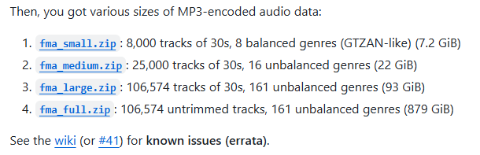
Data Sources
FMA (Free Music Archive) Dataset, pulled from github: https://github.com/mdeff/fma/
fma_small.zip
8000 mp3 files
7997 after errors
Fma_metadata.zip
tracks.csv
genres.csv (8 target genres)
features.csv
echonest.csv

Slide 5
Processing
For feature matrix
mp3 files stored in compressed format to save space. The sound files get stored as a 1D string of numbers
Used Librosa library to unpack these 1D strings into 2D images
Use sample rate to convert to 2D
Convert amplitude to decibels to better represent human hearing range
Transform decibels to [0,1] scale
Saved images into array (7,997 x 128 x 1291 x 1)
For targets
Extracted ID and genre
Used one-hot encoding to load into model (7,997 x 8)

Slide 6
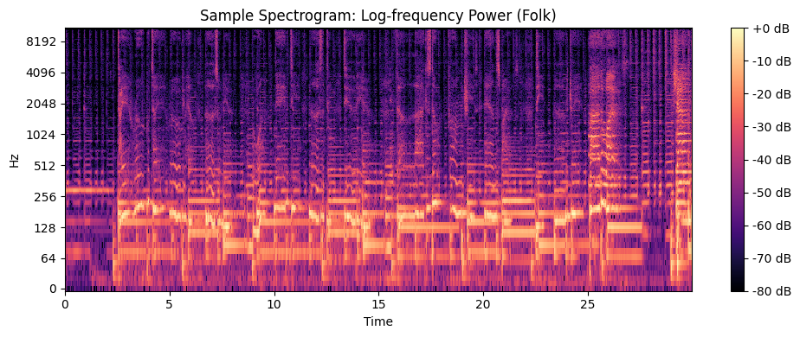
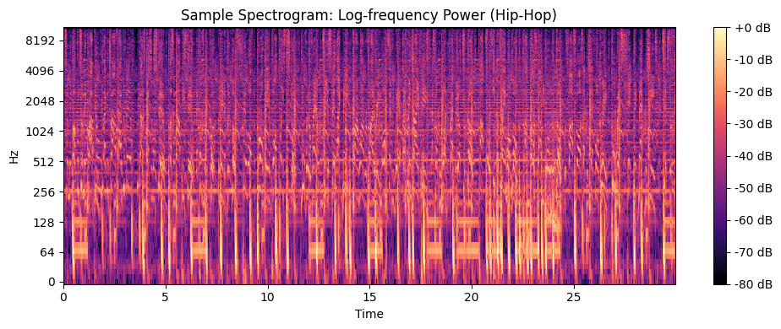
EDA

Slide 7
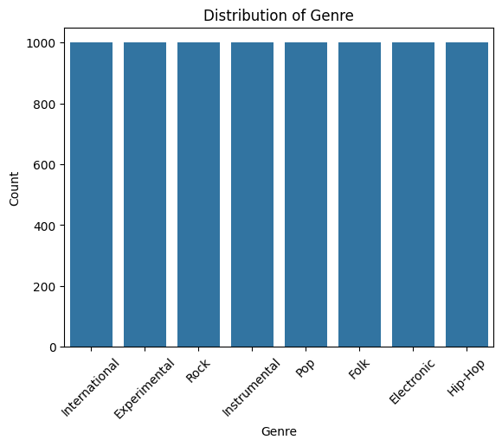
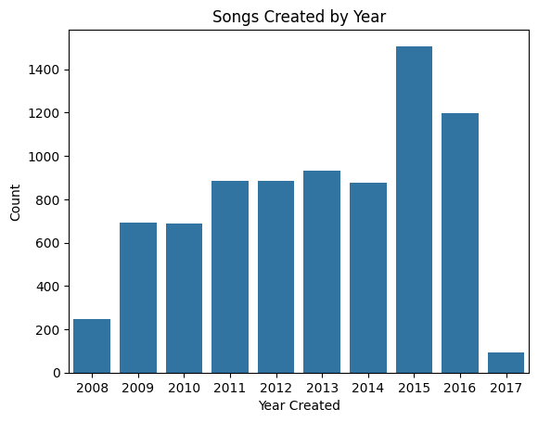
EDA

Slide 8
Modeling
Chose three architectures to explore
Convolutional Neural Network CNN
3 cycles of 2D Convolution layers followed by pooling
Convolution – Recurrent Neural Network Hybrid
Layers of CNN followed by Layers of RNN and regularization
Asymmetric CNN
Instead of using square kernels (n x n) used (n x m) with n ≠ m
Also used non-square pooling kernels

Slide 9
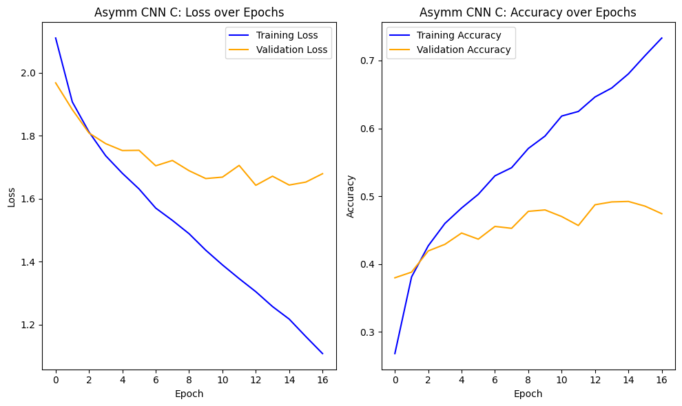
Results and Analysis
Measured categorical cross entropy loss and accuracy for the training and validation set of nine models, three in each architecture
Would start with a baseline model then tune hyperparameters like learning rate, regularization, and number of filters
Often ran into overfitting problems and bad training accuracy

Slide 10
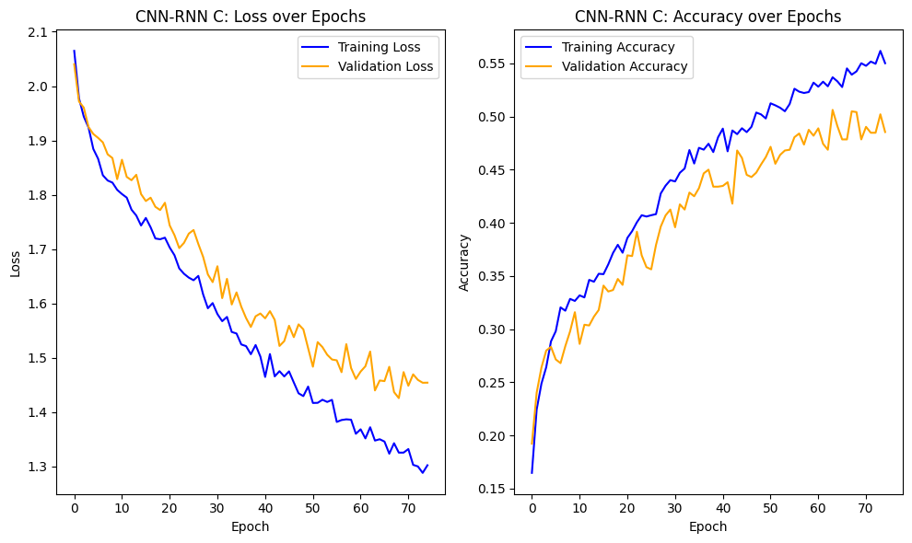
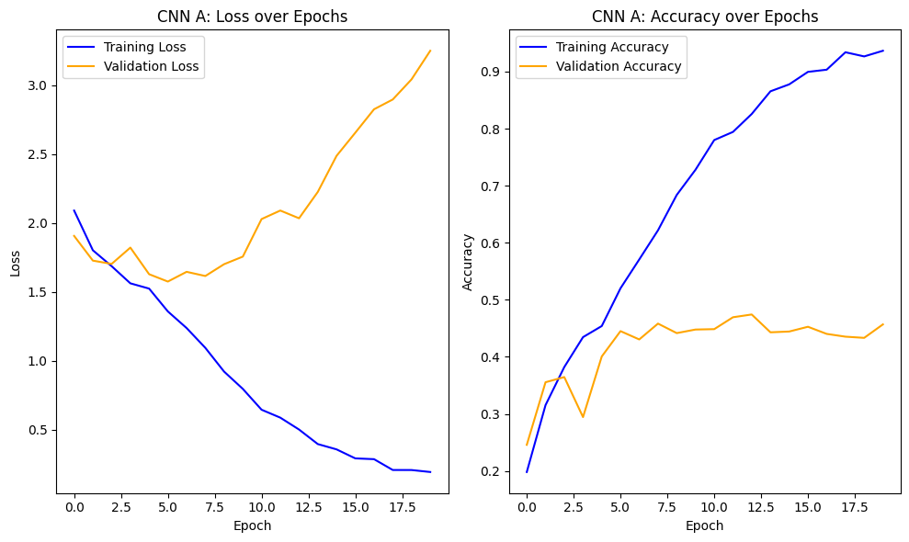
Results and Analysis

Slide 11
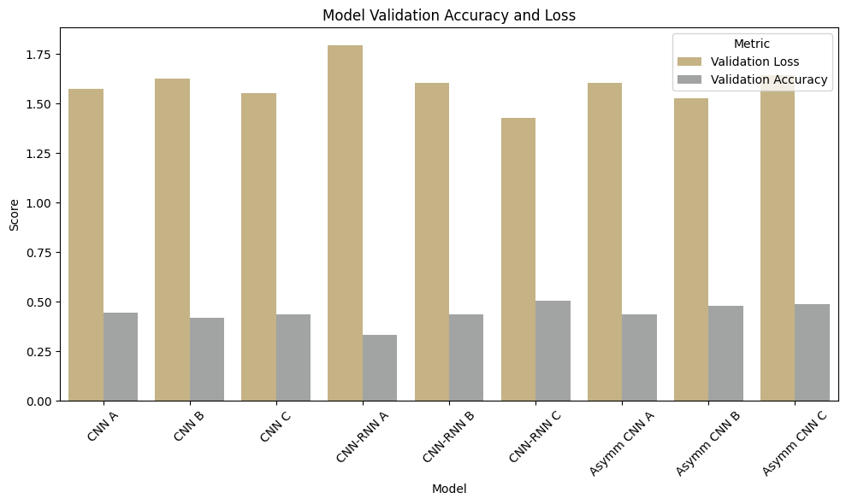
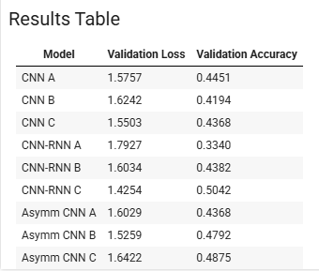
Results and Analysis
CNN-RNN Hybrid Model C the best performer: Loss = 1.4254, Acc = 0.4368

Slide 12
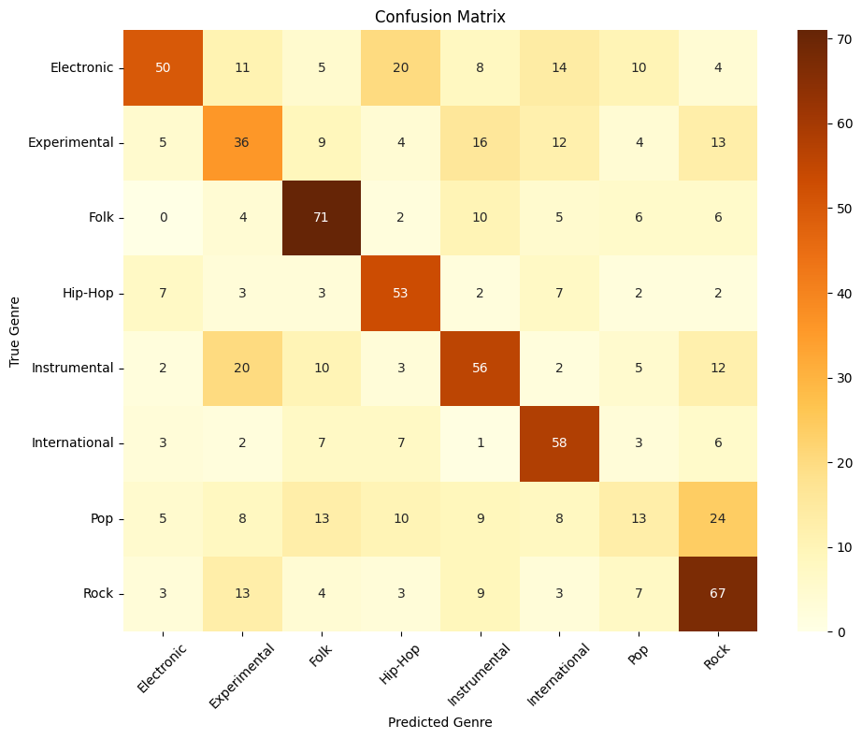
Conclusion
Final Model Accuracy = 0.505
Not great, but better considering 8 classes
Folk and Rock easiest to identify
Pop difficult to identify
Hybrid and Asymmetric models performed better
Future work
Would explore different processing parameters
Would expand on asymmetric kernel sizes tested

